Slide 1







Aptitude & Logical Reasoning Test Program
QuizWiz
"Aptitude mastery, made enjoyable."

Slide 2



The Project in a Nutshell
"QuizWiz is your ultimate platform for placement preparation. Designed with students in mind, it offers ease of use and immediate feedback on a diverse set of questions. Our project's primary goal is to deliver a comprehensive and interactive experience that helps students elevate their aptitude and logical reasoning skills, preparing them for success in placement assessments."

Slide 3
Project Workflow
1
2
3
4
5
STEP
STEP
STEP
STEP
STEP
Resource Gathering and System Study
Question Framing
(Round 1)
Scoreboard Implementation
OOPs-Based Code Implementation
Features and Development Goals
Collect topics, questions, and categories for the project.
Develop aptitude and logical reasoning questions, organizing them into relevant categories.
A user scoreboard to track progress while integrating scoring and ranking features.
Utilize Java's Object-Oriented Programming principles and concepts.
Enhance Multi-Platform Compatibility, User Progress History, and Gamification Elements.

Slide 4
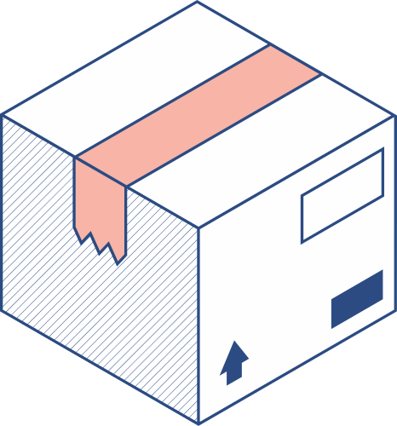


Modules/Concepts Integrated
Classes and Objects:
The code defines a class, "AptitudeTest," which encapsulates the main program logic. Objects of this class are created to execute the program.
2. Inheritance:
Although not explicitly present, we can leverage inheritance by creating subclasses for distinct question types, such as NumericalQuestion, VerbalQuestion, and LogicalQuestion. These subclasses inherit shared attributes and methods from a base Question class.
3.Polymorphism:
While not explicitly implemented, polymorphism can be utilized to handle various question types uniformly through a common interface or superclass.

Slide 5
Modules/Concepts Integrated
4. Encapsulation:
The AptitudeTest class encapsulates the primary program logic, and you can further encapsulate question-related data and methods within a Question class or its subclasses.
5. Abstraction:
Abstraction can be implemented by creating abstract classes or interfaces to define common methods that must be implemented by subclasses. Examples include displayQuestion and calculateScore.
6. Modularity:
The code showcases modularity by organizing questions into distinct categories (Numerical Reasoning, Verbal Reasoning, Logical Reasoning), treating them as separate modules.
7. Exception Handling:
Exception handling is not explicitly implemented but can be integrated to manage potential exceptions during user input processing.
8. Generics:
The code employs a simple generic class, Question, to handle questions of different types.

Slide 6


Modules/Concepts Integrated
9. Constructors and Methods:
Constructors and methods can be introduced to initialize objects and encapsulate behavior, such as score calculation and question presentation.
10. Static Members:
Static members have not been utilized in the provided code but could be employed for global constants, utility methods, or shared state, like a scoreboard.
11. Interfaces:
While not explicitly used, interfaces can be introduced to ensure that specific methods (e.g., displayQuestion, calculateScore) are implemented by classes representing distinct question types.
12. Final Classes/Methods And Protected Members:
The code doesn't employ final classes or methods, but they can be employed to prevent further subclassing or method overriding if required.

Slide 7

The rationale for selecting this topic
AS COLLEGE STUDENTS PREPARE TO EMBARK ON THEIR PROFESSIONAL CAREERS, THEY OFTEN FACE PLACEMENT ASSESSMENTS. OUR PROJECT'S EMPHASIS ON APTITUDE AND LOGICAL REASONING DIRECTLY AIDS IN THEIR READINESS FOR THESE CRITICAL EXAMINATIONS, ARMING THEM WITH ESSENTIAL SKILLS FOR A SMOOTH TRANSITION INTO THE JOB MARKET.
2. IN AN INCREASINGLY DIGITAL WORLD, PROJECTS LIKE YOURS PREPARE STUDENTS FOR THE DIGITAL ASPECTS OF PLACEMENT EXAMS AND JOB ASSESSMENTS. IT HELPS THEM BECOME MORE DIGITALLY LITERATE.
3. THERE IS A HIGH DEMAND FOR TOOLS AND RESOURCES THAT HELP STUDENTS IMPROVE THEIR APTITUDE AND LOGICAL REASONING SKILLS. YOUR PROJECT AIMS TO FILL THIS GAP BY PROVIDING AN INTERACTIVE AND TAILORED PLATFORM FOR PRACTICE AND LEARNING.

Slide 8




RESOURCES USED
https://www.indiabix.com/aptitude/questions-and-answers/
https://www.ambitionbox.com/topics/aptitude/questions-and-answers
https://www.geeksforgeeks.org/aptitude-questions-and-answers/

Slide 9
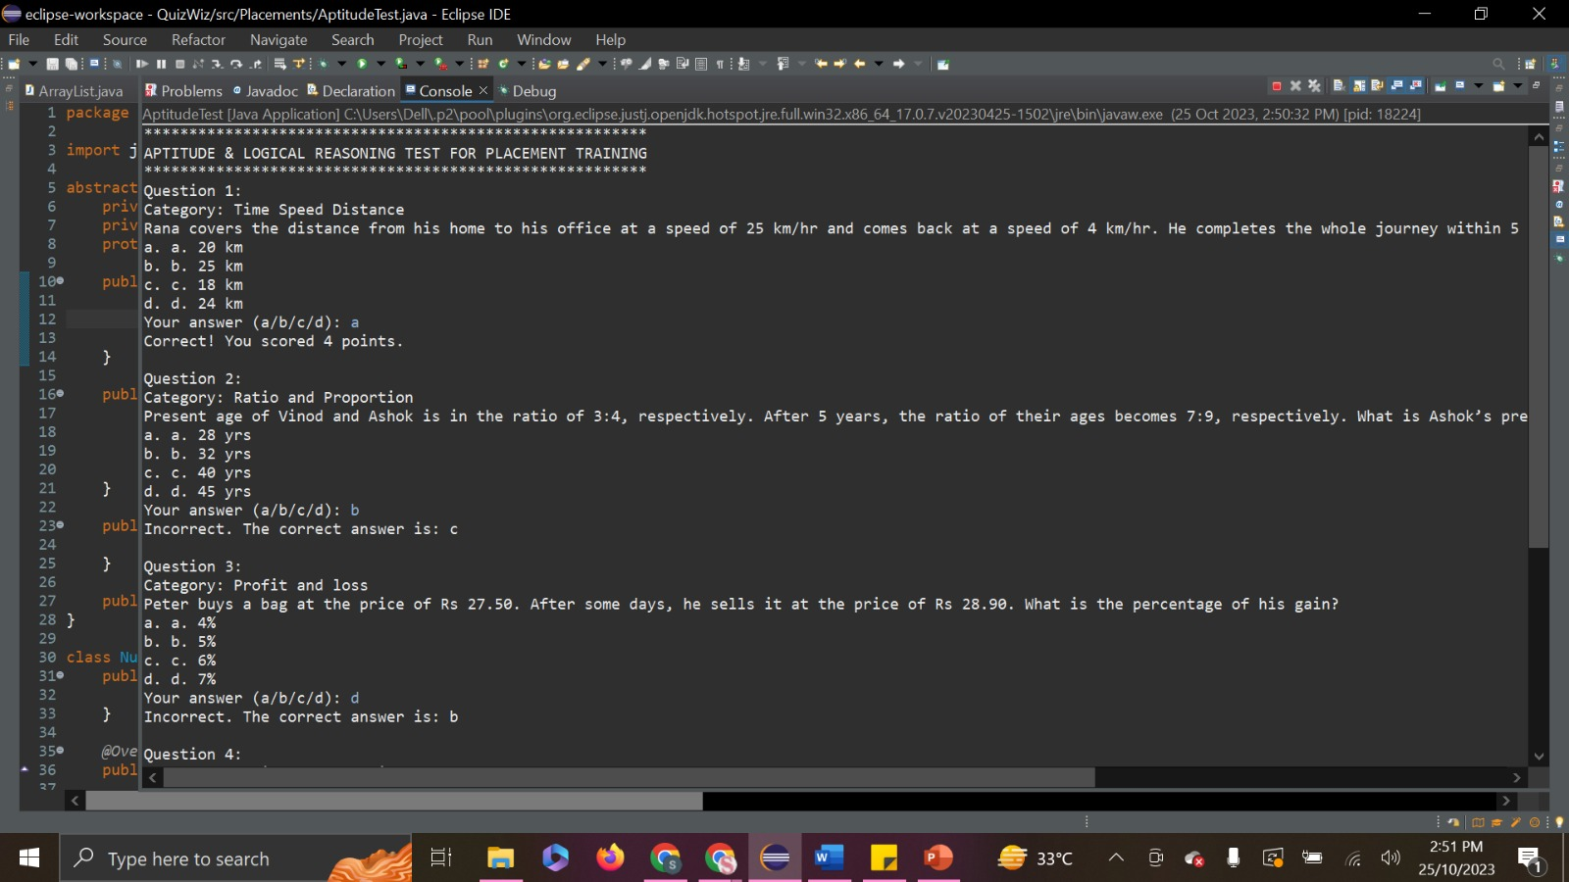

Outcome:

Slide 10
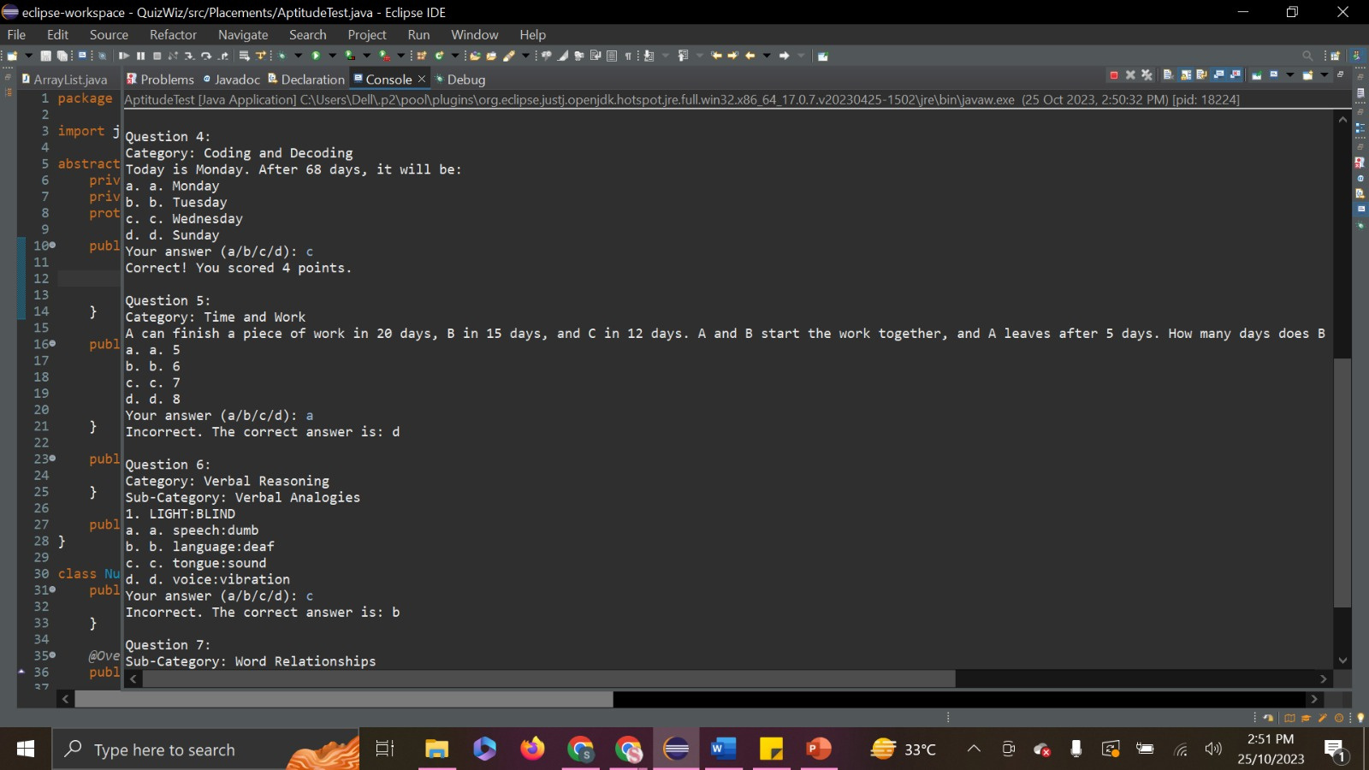
Outcome:

Slide 11

Outcome:

Slide 12


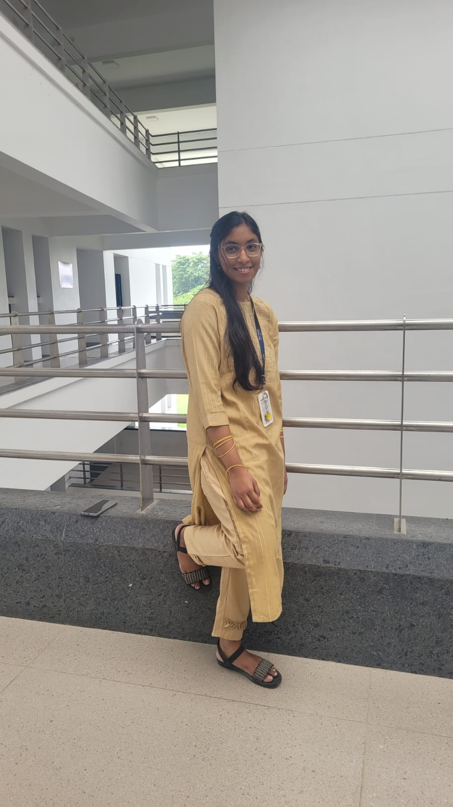
The Team
S SOWMITHAA SRI
NVS KEERTHANA
LINGAMALLU
22011101096
22011101073

Slide 13


